Slide 1
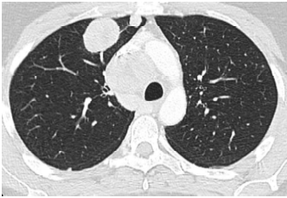
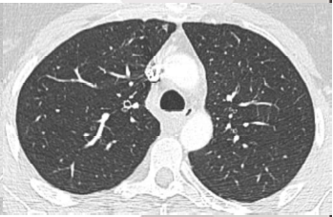
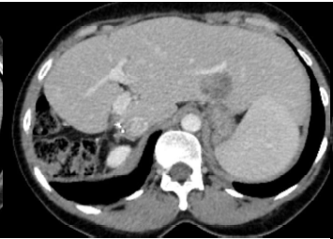
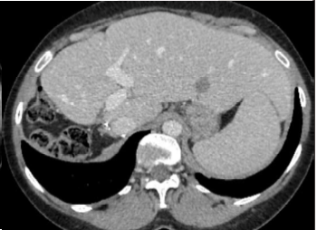
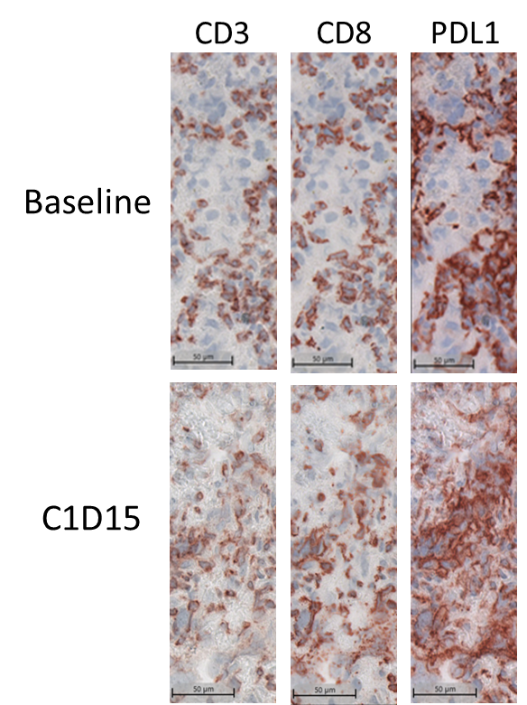
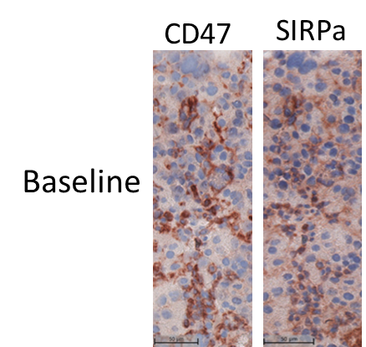
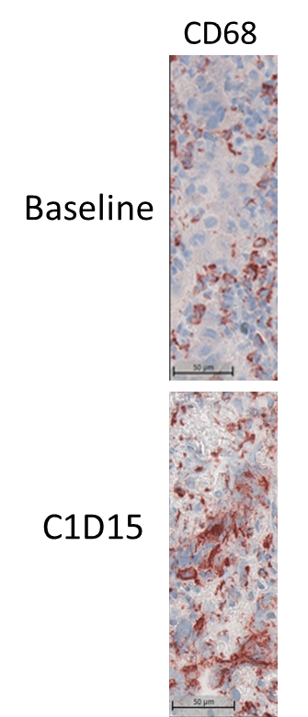
Biomarker analyses from the Phase I clinical trial of the first-in-class SIRPα immune checkpoint inhibitor BI 765063 in patients with advanced solid tumors
#1993
Stéphane Champiat,¹* Philippe A. Cassier,² Nuria Kotecki,³ Carlos Gomez-Roca,⁴ Aurélien Marabelle,¹ Armelle Vinceneux,² Christiane Jungels,³ Mabrouk Elgadi,⁵ Ralph Graeser,⁵ Thomas Vandewalle,⁶ Isabelle Girault,⁷ Nina Salabert-Le Guen,⁷ Nicolas Poirier,⁷ Bérangère Vasseur,⁶ Dominique Costantini,⁶ Claudia Fromond,⁶ Jean-Pierre Delord⁴
¹Gustave Roussy Cancer Campus, Villejuif, France; ²Centre Léon Bérard, Lyon, France; ³Institut Jules Bordet, Brussels, Belgium; ⁴Institut Claudius Regaud, IUCT-Oncopole, Toulouse, France; ⁵Boehringer Ingelheim Pharmaceuticals, Inc., Ridgefield, CT, USA; ⁶OSE Immunotherapeutics, Paris, France; ⁷OSE Immunotherapeutics, Nantes, France
Introduction
Results
Results
BI 765063 is a first-in-class, humanized IgG4 monoclonal antibody that binds selectively to the V1 allele of signal regulatory protein α (SIRPα) blocking the SIRPα/CD47 “don't eat me” pathway (Figure 1)^{1,2}
Preclinical studies showed that SIRPα blockade led to macrophage and T-cell recruitment into the tumor xenografts, and induced upregulation of chemokines, cytokines and adaptive immune function genes in human tumor explants²
Figure 1. BI 765063 (anti-SIRPα) mechanism of action
Figure 3. Immunophenotyping of peripheral monocytes from patients treated with BI 765063
Figure 5. CT scans of a patient with HCC show a partial response maintained for >18 months, with treatment still ongoing; a) and b): lung before and after treatment with BI 765063 monotherapy, respectively; c) and d): liver before and after treatment with BI 765063 monotherapy, respectively
Inactive
macrophage
Tumor
cell
BI 765063
Tumor cell
phagocytosis
15
V1/V1
15
V1/V2
Monotherapy 1 and 3 mg/kg
Active
macrophage
Monotherapy 6 and 12 mg/kg
a)
b)
c)
d)
CD47
10
10
Monotherapy 18, 24, and 36 mg/kg
Active
dendritic cell
CD80+/CD14⁺ (%)
CD80+/CD14⁺ (%)
SIRPα
Modified
chemokine
secretion
5
5
BI 765063
Macrophage
migration
0
0
Figure 6. Tumor microenvironment analysis of the patient with HCC showing a partial response
T cell
migration
C1D1 predose
C2D1 predose
C1D1 predose
C2D1 predose
C1D1 predose
C2D1 predose
C1D1 predose
C2D1 predose
C1D1 predose
C2D1 predose
C1D1 predose
Inactive
dendritic cell
Chemokine
receptor
C1D2
C2D1 predose
C1D15
C1D2
C1D15
C1D2
C1D15
C1D2
C1D15
C1D2
C1D15
C1D2
C1D15
a)
d)
Here we report biomarker analyses from the monotherapy cohort of the ongoing Phase I trial (NCT03990233)
SIRPγ
40,000
40,000
30,000
30,000
20,000
20,000
Objective and Methods
MFI CD40⁺/CD14⁺
MFI CD40⁺/CD14⁺
Please scan the QR code for additional details on methods
10,000
10,000
Objective of the biomarker analysis
Methods
This is an open-label, multicenter Phase I trial in patients genetically SIRPα V1/V1 homozygous or V1/V2 heterozygous with advanced solid tumors who had failed or were ineligible for standard therapy
Paired tumor biopsies were collected before treatment and two weeks after first BI 765063 infusion
0
0
To characterize the impact of BI 765063 on peripheral blood immune cells (PBMCs), as well as on the tumor microenvironment
C1D1 predose
C2D1 predose
C1D1 predose
C2D1 predose
C1D1 predose
C2D1 predose
C1D1 predose
C2D1 predose
C1D1 predose
C2D1 predose
C1D1 predose
C1D2
C2D1 predose
C1D15
C1D2
C1D15
C1D2
C1D15
C1D2
C1D15
C1D2
C1D15
C1D2
C1D15
Treatment with BI 765063 monotherapy at 18–36 mg/kg led to an apparent transient increase in the percentage of activated CD80⁺/CD14⁺ and CD40⁺/CD14⁺ monocytes in V1/V1 and V1/V2 patients at Cycle 1 Day 2
b)
Patient demographics and disease characteristics
Figure 4. NanoString tumor expression profiling
c)
A total of 50 patients (V1/V1: 26; V1/V2: 24) received BI 765063 IV from 0.02 mg/kg to 36 mg/kg, q3w (Table 1)
The most frequent tumor types were:
Ovarian (n=9)
Colorectal (n=8)
NSCLC (n=4)
Breast (n=4)
Melanoma (n=3)
Kidney (n=3)
Table 1. Patient demographics and disease characteristics
a) The patient’s tumor biopsy showed high CD8⁺ T-cell infiltration at baseline
b) At C1D15, sustained CD8⁺ T-cell tumor accumulation and higher PD-L1 CPS (48% at baseline vs 75% at C1D15) were observed
c) Increased CD68⁺ macrophage infiltration was observed at C1D15
d) Baseline tumor biopsy showed that 66% of HCC tumor cells were CD47⁺, and 87% of CD68⁺ macrophages were SIRPα⁺
 | All patients (N=50)
Median age, years (range) | 60 (37–76)
Female, n (%) | 28 (56.0)
White, n (%) | 49 (98.0)
Metastatic disease at screening, n (%) | 50 (100.0)
ECOG PS at baseline, n (%)
0 | 26 (52.0)
1 | 24 (48.0)
Median number of prior lines of systemic therapies, n (range) | 5 (1–10)
LRRC32
THY1
4
ZEB2
CXorf36
TLR9
PECAM1
NID2
PDGFRB
TGFB3
COL6A3
OLFML2B
JAG1
3
CDH11
ANGPT2
TGFBR2
TCL1A
-log₁₀ (P value)
COL5A1
2
Key findings and conclusions
Results
1
These data strongly suggest that the first-in-class SIRPα inhibitor BI 765063 acts as an immunomodulator of the tumor microenvironment, leading to upregulation of IFNγ signaling and MHC class II antigen presentation pathways in both V1/V1 and V1/V2 patients; this is consistent with preclinical findings, and in-line with its mechanism of action
Increases in CD80⁺ and CD40⁺ monocyte expression in the blood suggest a rapid engagement of the innate immune system. The on-treatment biopsy of the responder showed an increase in CD68⁺ macrophages and sustained CD8⁺ T-cell infiltration, accompanied by higher PD-L1 expression on tumor cells
These early signals will be further evaluated in similar samples from the ongoing expansion cohorts in more homogeneous patient populations
Figure 2. BI 765063 receptor occupancy (RO) on V1 SIRPα allele in peripheral CD14⁺ monocytes
0
-1.0
-0.5
0.0
0.5
1.0
log₂ fold change
V1/V1
V1/V2
DOWN at C1D15
UP at C1D15
a)
100
b)
100
1 mg/kg
80
80
3 mg/kg
60
60
6 mg/kg
RO (%)
RO (%)
12 mg/kg
40
40
18 mg/kg
Scan this QR code or visit the URL for an electronic copy of the poster, supplementary content, and a list of abbreviations†
Scan this QR code or visit the URL for a webpage featuring all BI-supported publications at AACR 2022
*Corresponding author email address: Stephane.Champiat@gustaveroussy.fr
†Copies of this poster obtained through Quick Response (QR) Code are for personal use only and may not be reproduced without written permission from the authors
20
20
24 mg/kg
36 mg/kg
0
0
0
5
10
15
20
25
0
5
10
15
20
25
a) In paired tumor biopsies (n=26), IFNγ, MHC class II antigen presentation gene pathways, and CCL7 transcripts appeared to be upregulated at Cycle 1 Day 15 in patients with high systemic exposure (≥100 µg/mL); b) in contrast, metastasis pathways are upregulated at Cycle 1 Day 15 in patients with low systemic exposure (≤100 µg/mL)
Time (days)
Time (days)
https://bit.ly/35Fqe72
https://bit.ly/3vu4Xrb
a) BI 765063 full RO was achieved at trough levels (Cycle 2 Day 1, pre-dose) in V1/V1 patients treated with doses of 6 mg/kg and higher; b) RO was more heterogenous in V1/V2 patients, ranging from 40% to 80% and reaching an apparent saturation at 12 mg/kg and higher
References
1. Delord J-P, et al. Blood 2019;134(Suppl1):1040; 2. Gauttier V, et al. J Clin Invest 2020;130:6109–23
Presented at the American Association for Cancer Research (AACR) Congress, New Orleans, Louisiana, United States, April 8–13, 2022
This trial was funded by OSE Immunotherapeutics and Boehringer Ingelheim. The authors were fully responsible for all content and editorial decisions, were involved at all stages of poster development and have approved the final version. The authors did not receive payment related to the development of the poster. Acknowledgement: HalioDx (Marseille, France), now part of Veracyte, for the IHC and NanoString analysis. Medical writing support for the development of this poster, under the direction of the authors, was provided by Steven Kirkham, PhD, of Ashfield MedComms, an Ashfield Health company, and funded by Boehringer Ingelheim

