Slide 1
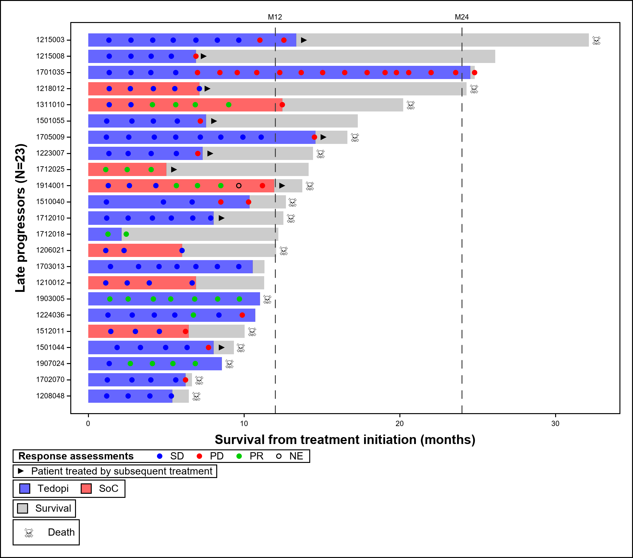
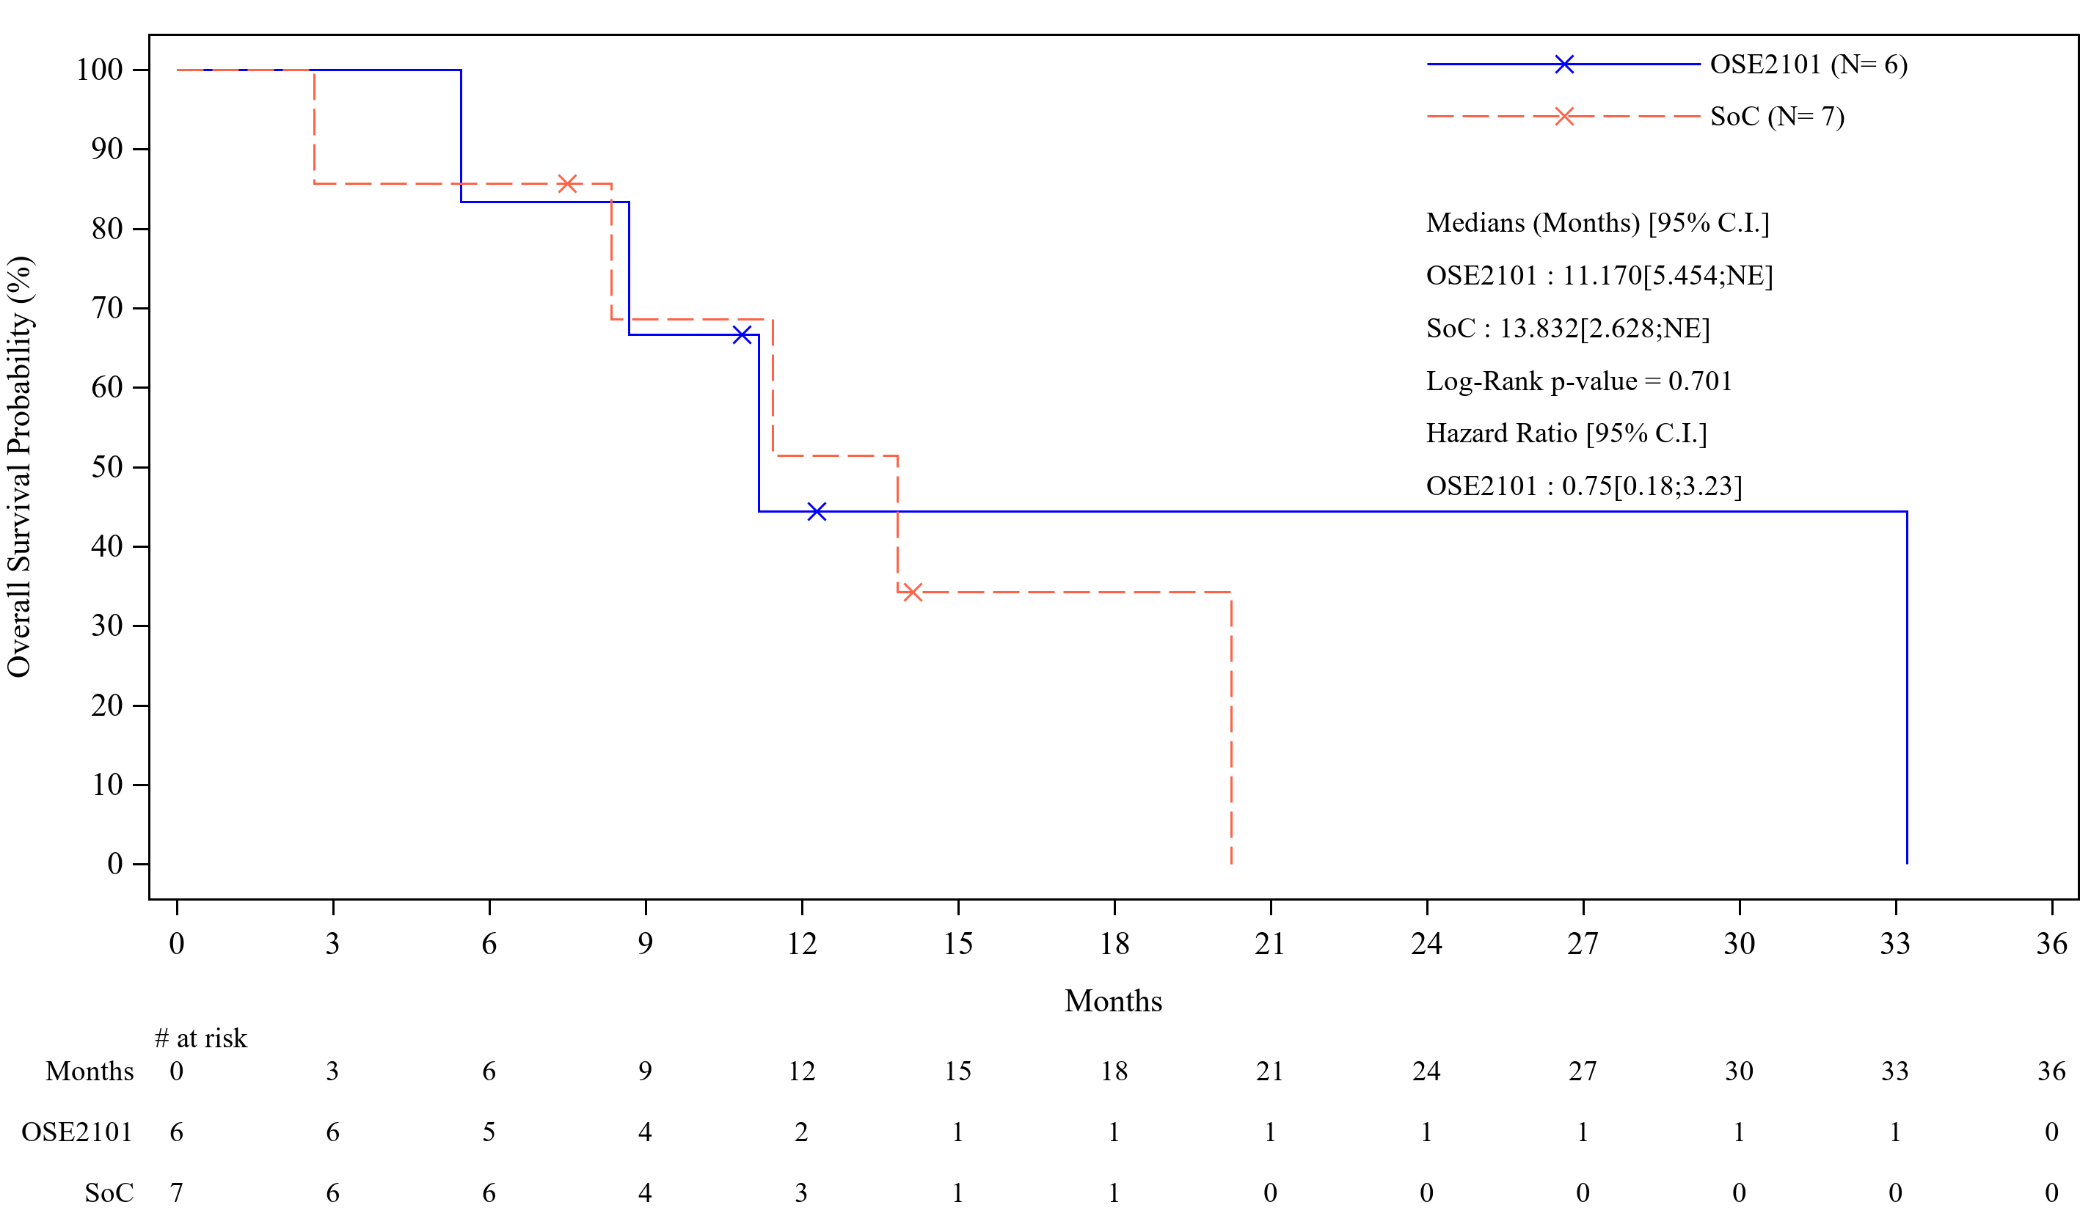
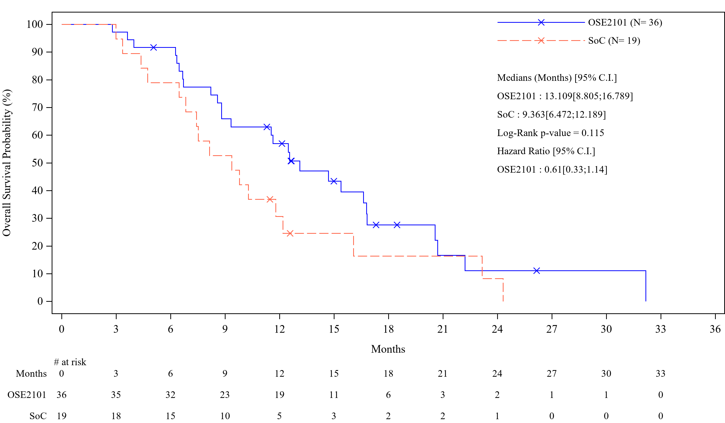
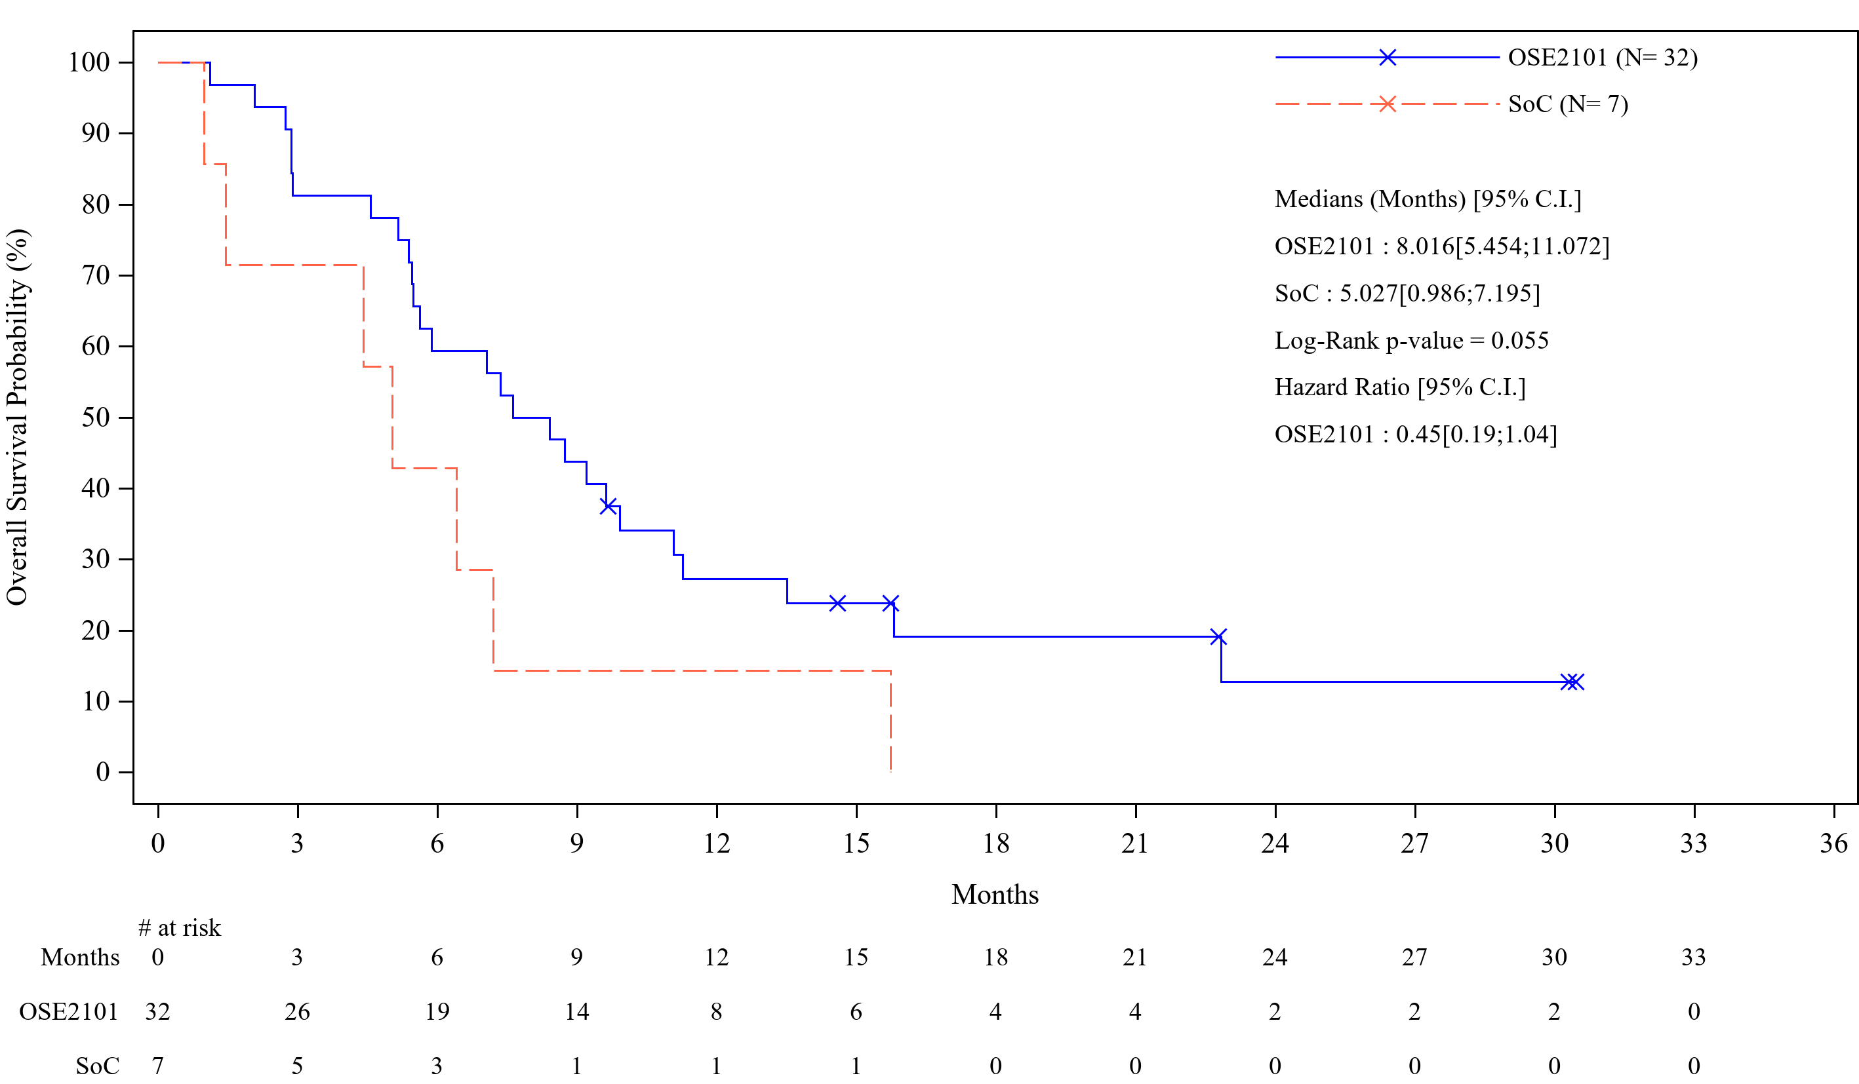
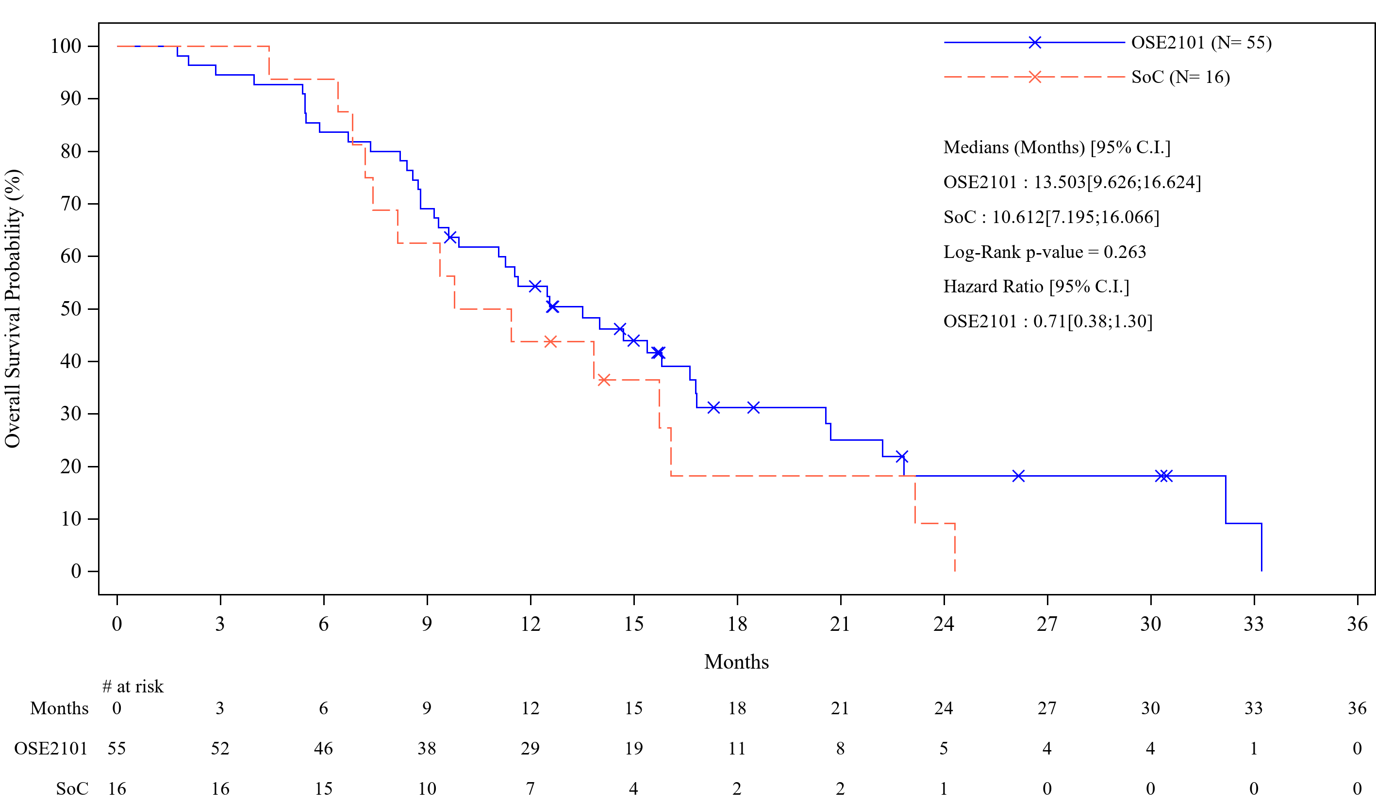
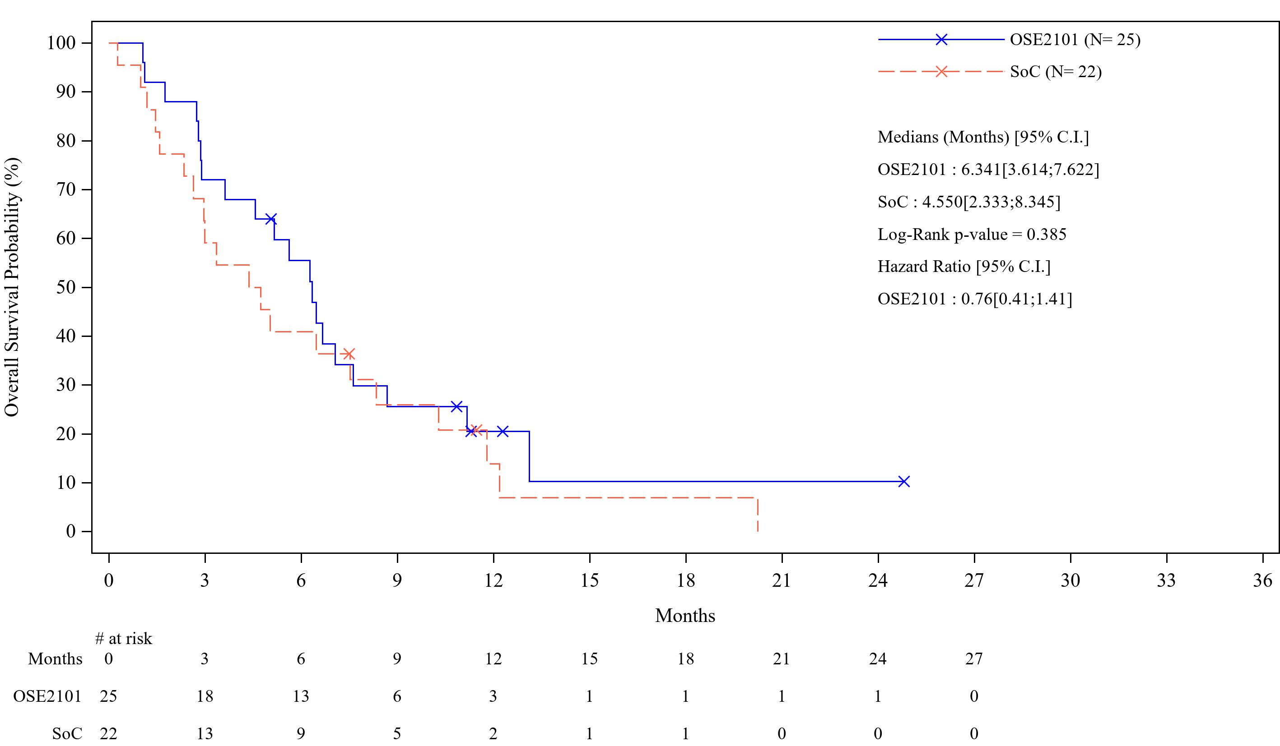
1019P
Pattern of Clinical Activity of Anticancer Vaccine OSE2101 in HLA-A2+ non-small cell lung cancer
(NSCLC) Patients after Failure to Immune Checkpoint Inhibitors (IO) in Phase 3 Atalante-1 randomized trial
Authors: ¹M.R. Garcia Campelo, ²E. Felip, ³B. Besse, ⁴M. Cobo Dols, ⁵E. Quoix, ⁶A.-C. Madroszyk Flandin, ⁷F. Cappuzzo, ⁸F. Denis, ⁹W. Hilgers, ¹⁰G. Romano, ¹¹D. Debieuvre, ¹²D. Galetta, ¹³E. Baldini, ¹⁴S. Viteri Ramirez, ¹⁵M. Duc Phan, ¹⁶W. Schuette, ¹⁷A. Zer, ¹⁸B. Vasseur, ¹⁹R. Dziadziuszko, ²⁰G. Giaccone
¹Complejo Hospitalario Universitario A Coruña, A Coruña, Spain; ²Vall d'Hebron University Hospital and Vall d’Hebron Institute of Oncology, Barcelona, Spain; ³Gustave Roussy, Villejuif, France; ⁴Hospital Regional Universitario Málaga Carlos Haya, Malaga, Spain; ⁵Hopitaux Universitaires de Strasbourg - Nouvel Hopital Civil, Strasbourg, France; ⁶ Institut Paoli-Calmettes, Marseille, France; ⁷IRCCS Regina Elena National Cancer Institute, Rome, Italy; ⁸Institut Inter-Régional de Cancérologie Jean Bernard-Elsan, Le Mans, France; ⁹Sainte Catherine Cancer Center, Avignon, France; ¹⁰Ospedale Vito Fazzi - ASL Lecce, Lecce, Italy; ¹¹Groupe Hospitalier de la Région Mulhouse Sud Alsace, Mulhouse, France; ¹²Istituto Tumori Bari Giovanni Paolo II - IRCCS, Bari, Italy; ¹³Ospedale San Luca, Lucca, Italy; ¹⁴Instituto Oncológico Dr. Rosell, Hospital Universitario Dexeus, Grupo Quironsalud, Barcelona, Spain; ¹⁵University of Oklahoma Health Sciences Center, Oklahoma City, United States of America; ¹⁶Martha-Maria City Hospital Halle-Doelau, Halle, Germany; ¹⁷Davidoff Cancer Center, Rabin Medical Center, Petah Tikva, Israel; ¹⁸OSE Immunotherapeutics, Paris, France; ¹⁹ Medical University of Gdansk, Gdansk, Poland; ²⁰Weill Cornell Medicine, New York, MD, United States of America
Background:
OSE2101 (Tedopi) is a cancer vaccine increasing median overall survival (mOS) by 3.6 months with HR of 0.59 (p=0.017) versus chemotherapy in HLA-A2+ NSCLC patients with IO secondary resistance after sequential CT-IO¹.
The objective of this analysis was to explore the pattern of activity of OSE2101 compared to chemotherapy.
Figure 1: Swimmer-plot of Late Progressors with SoC (red) and OSE2101 (blue)
Results (2): OS by Best Response under OSE2101 and SoC
Figures 2: Survival (Kaplan Meier) in PR (2a), SD (2b) and DP (2c) under SoC and OSE2101
Methods:
118 NSCLC EGFR and ALK negative patients were randomized (2:1) in OSE2101 (n=80) or in SoC (docetaxel or pemetrexed, n=38)
Pattern of activity of OSE2101 was explored :
in Late Progressors (LP) defined as no RECIST 1.1 nor clinical Progressive Disease (PD) within the first 6 months after randomization.
In all patients by describing OS according to the best response to study treatment and the administration of post progression anticancer treatment in OSE2101 group and in SoC.
2a: PR
2b: SD
2c: DP
Partial Response (PR) n=13 | Stable Disease (SD) n=55 | Progressive Disease (PD) n=74
HR=0.75 [95%CI 0.18-3.23] | HR=0.61 [95%CI 0.33-1.14] | HR=0.45 [95%CI 0.19-1.04]
Results (3): OS according to Anticancer Treatment Post Progression
Figures 3: Survival (Kaplan Meier) with (3a) or without (3b) anticancer treatment post progression in SoC and OSE2101
Conclusion:
In NSCLC patients with IO secondary resistance, late progressors with OSE2101 were mainly driven by long Stable Disease.
Deconvolution of OS curves by Best Response was better with OSE2101 compared to SoC. Interestingly, the OSE2101 effect was particularly higher in patients with Stable Disease or Progressive Disease. This suggest that the cancer vaccine OSE2101 may act as an anti-tumor brake in controlling the tumor growth regardless of best response.
Regardless the use of post progression anticancer treatment, OS was in favor of OSE2101 compared to SoC confirming the activity of the vaccine as stand alone.
Results (1):
Late Progressors (LP):
LP was observed in 16 (20%) patients with OSE2101 and 7 (18%) with SoC.
LP included 4 (25%) patients with PR and 12 (75%) patients with prolonged SD with OSE2101 and 3 (43%) PR and 4 (57%) SD with SoC (Figure 1).
Compared to early progressors (n=58) in OSE2101 group, LP shown less stage IV at study entry, lower number of metastatic sites, lower liver and brain met, longer duration of prior IO and a longer time since end of CT.
mOS was 14.7 months with 1-year OS rate of 68% with OSE2101 and mPFS was 8.8 months with 23% of patients progression-free at 1-year.
3a: with
3b: without
With anticancer treatment post progression n=71 | Without anticancer treatment post progression n=47
HR=0.71 [95%CI 0.38-1.30] | HR=0.76 [95%CI 0.41-1.41]
Author Contact: MA.Rosario.Garcia.Campelo@sergas.es
We thank all investigators and their study team, all patients and their families, P. Attali (MD) for his support in writing the abstract and J. Le Boulicaut, C. Josse, F. Montestruc (eXYSTAT) for biometry.
Reference: 1. B Besse et al; #47LBA ESMO 2021 in Annals of Oncology (2021) 32 (suppl_5): S1283-S1346. 0.1016/annonc/annonc741
Copies of this poster are for personal use only and may not be reproduced without permission from ESMO and the author of this poster

