Slide 1

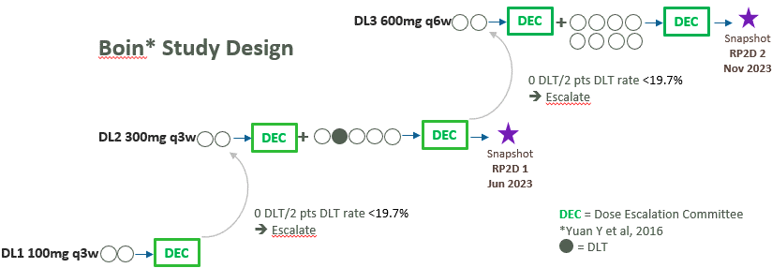
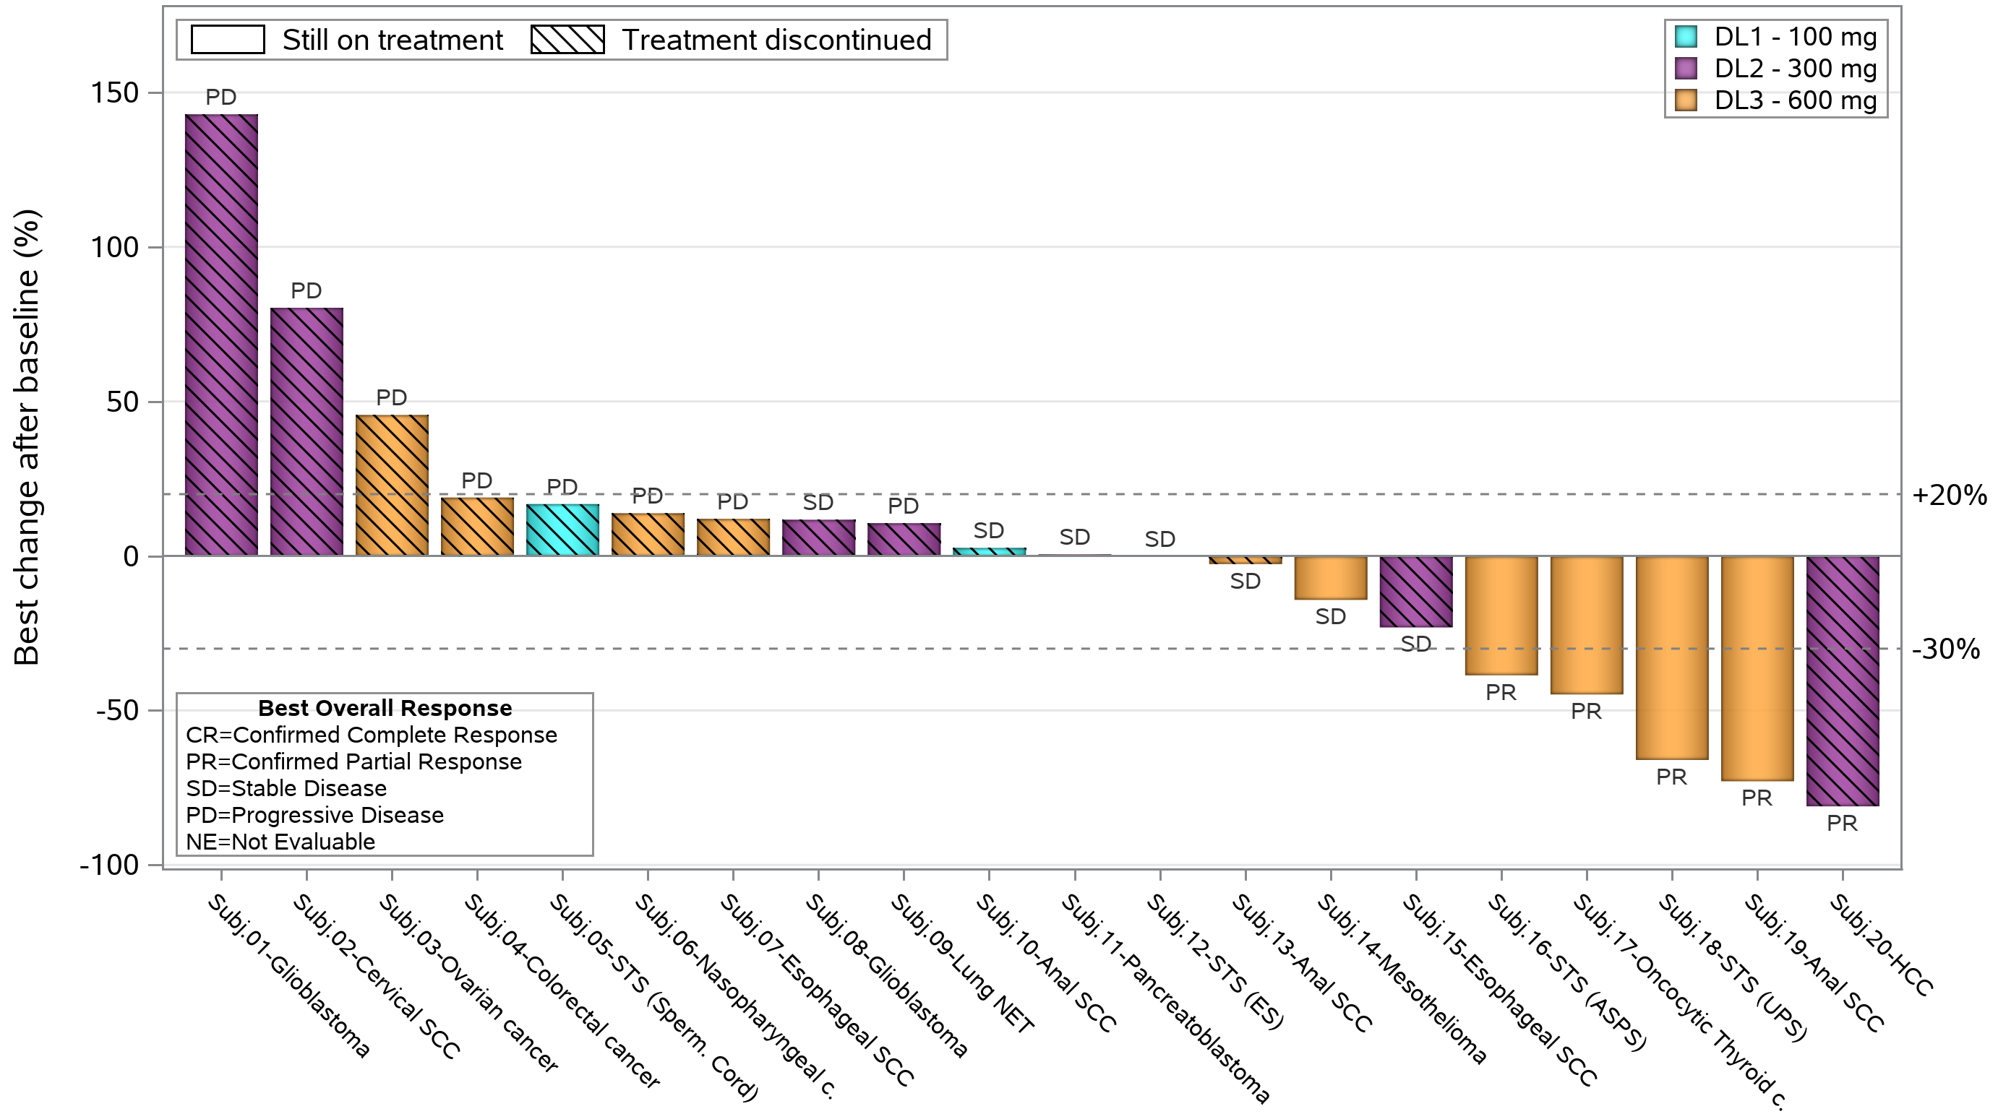
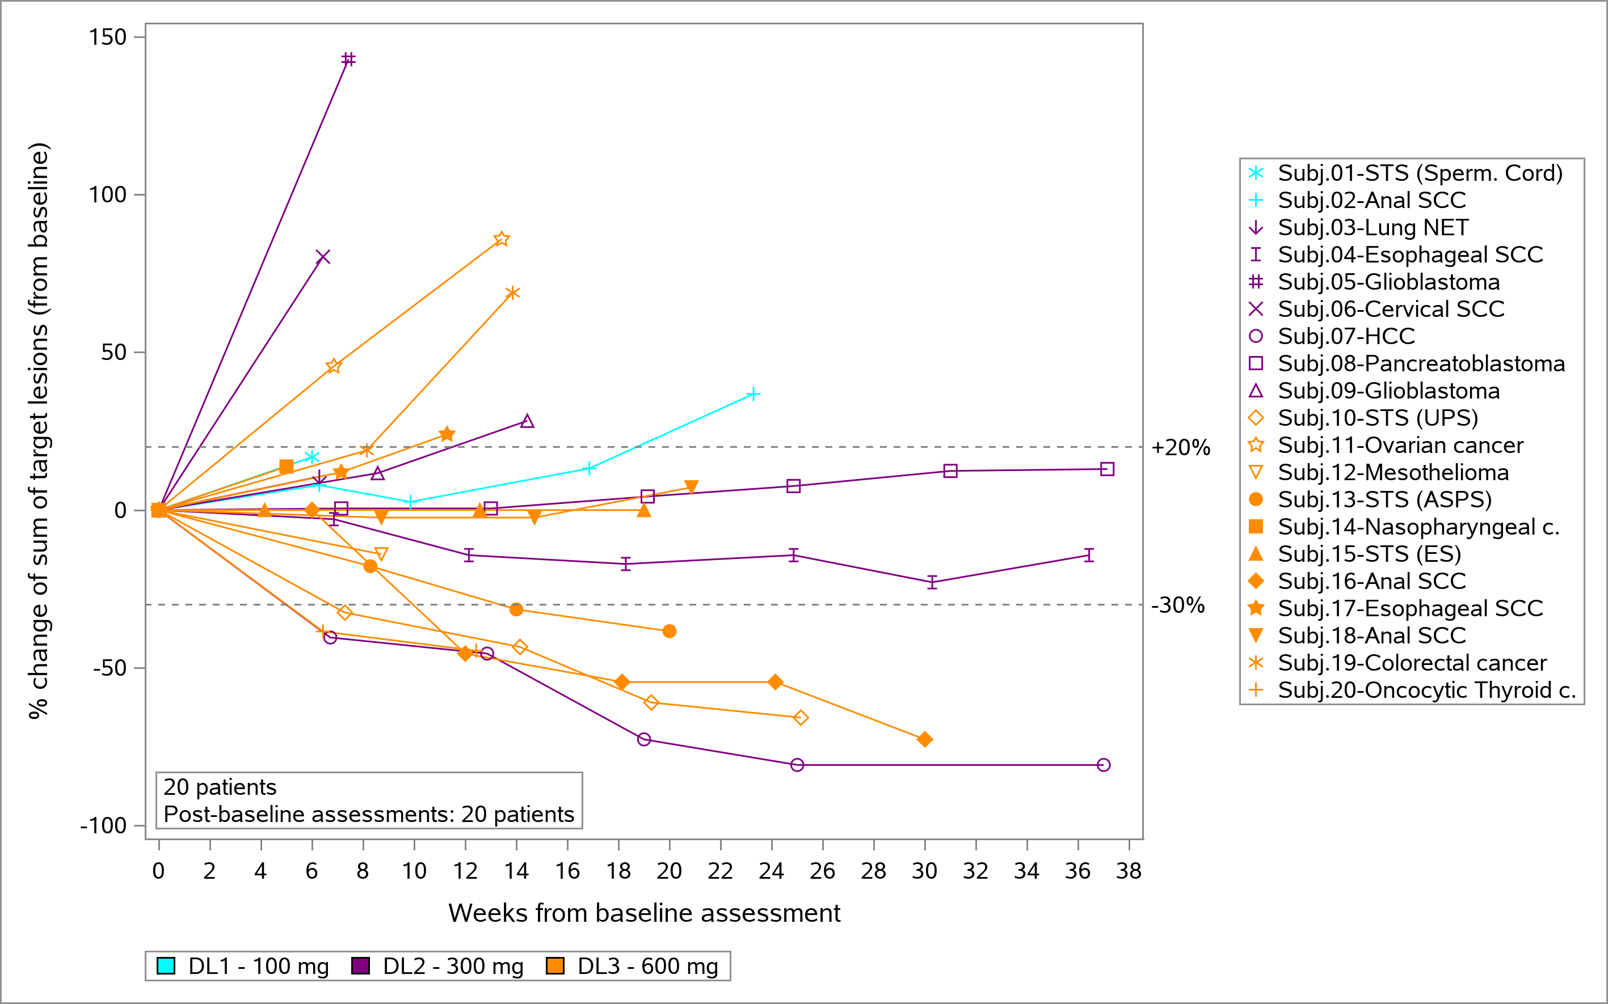
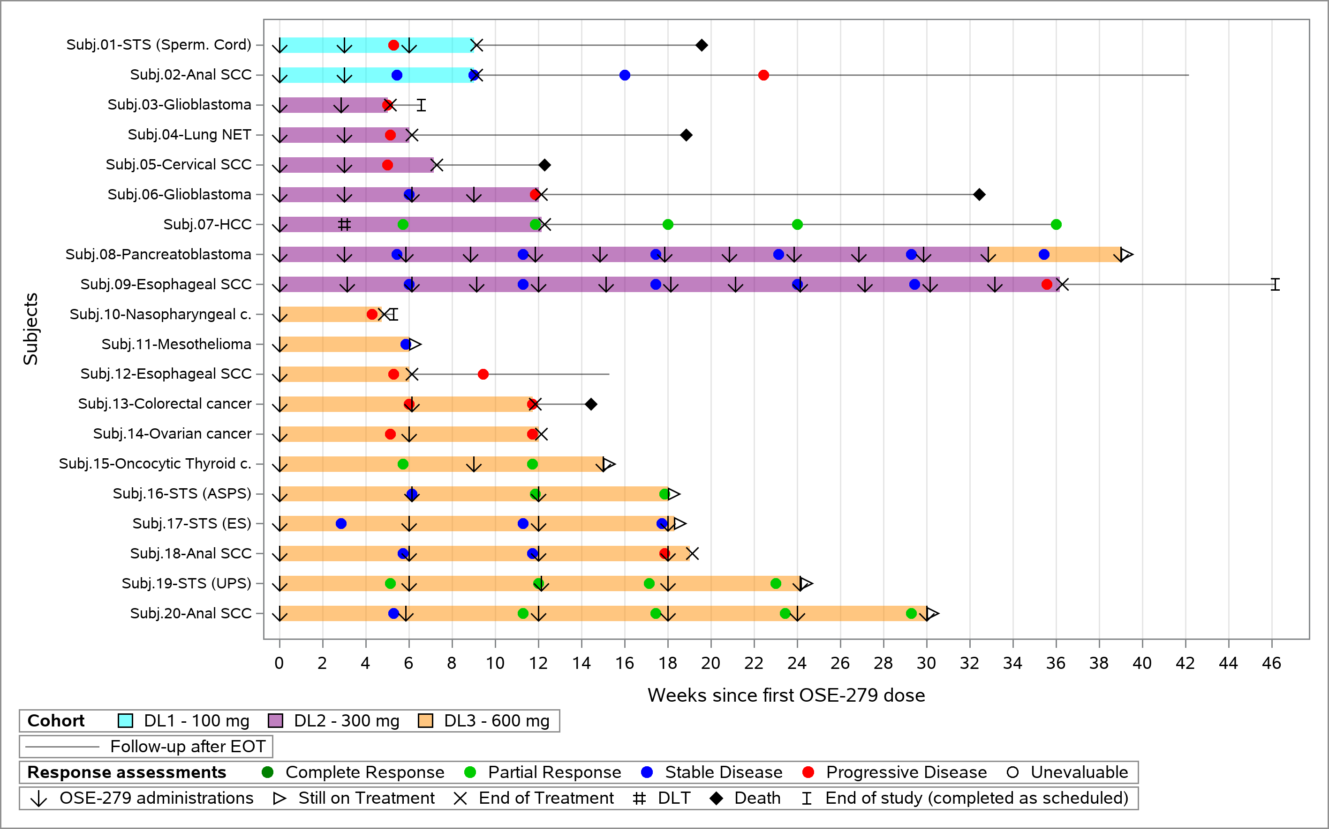
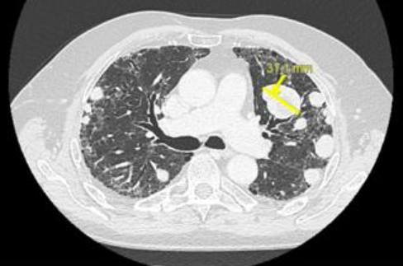
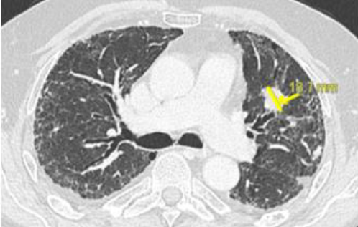
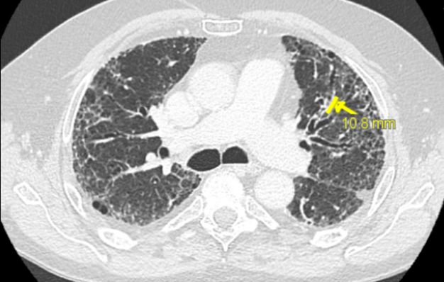
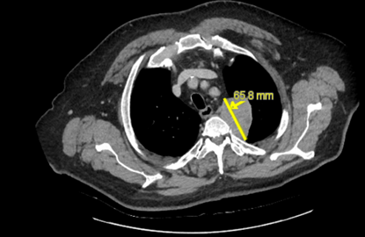
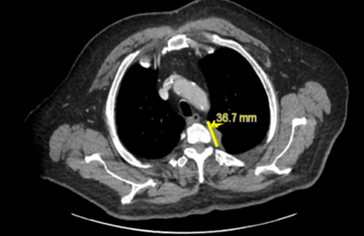
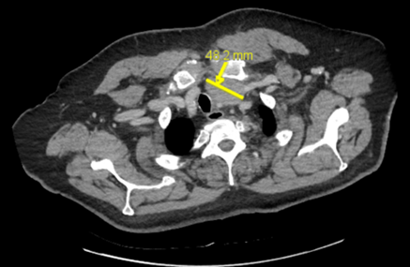
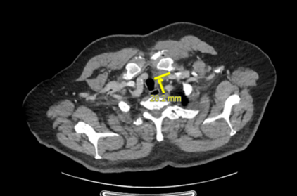
Abstract # 368; FPN 30P
OSE279, a PD-1 blocking monoclonal antibody, as future backbone of a bifunctional checkpoint inhibitor platform: preliminary results of a First-In-Human (FIH) study in subjects with advanced malignancies
Authors: M. Robert¹, N. Kotecki³, C. Gomez-Roca², C. Massard⁴, S. Postel-Vinay⁵, C. Chevalier⁶, L. Cordonnier⁶, A. Morello⁶, M. Déramé⁶, C. Josse⁷,
S. Comis⁶, N. Poirier⁶, P. Cassier⁸
¹Institut de Cancerologie de l'Ouest, Saint-Herblain, ARPEGO Network; ²Institut Jules Bordet, Anderlecht; ³Oncopole, Toulouse;; ⁴Centre Eugène Marquis, Rennes; ⁵Institut Gustave Roussy, Villejuif;
⁶OSE Immunotherapeutics, Nantes; ⁷Exystat, Malakoff; ⁸Centre Léon Bérard, Lyon
Background
Anti-PD-1 antibodies have shown significant clinical efficacy with manageable safety. OSE279 is a humanized S228P- IgG4 monoclonal bivalent antibody against PD-1 which will be further used as the anti-PD-1 backbone component of a bifunctional checkpoint inhibitor BiCKI® platform. OSE279 has a full antagonist activity against PD-1, similarly to pembrolizumab or nivolumab; simulations showed that trough Receptor Occupancy (RO) would be 94.1±36.9% and 98.3±36.8% at 100 mg and 300 mg, respectively; NOAEL was determined in monkey at 100 mg/kg given for 1 month.
A phase I/II study is underway to determine MTD and/or RP2D, efficacy, safety and tolerability, PK and PD profiles of OSE279 in subjects with refractory malignancies, with no standard treatments
Q3w and q6w regimens were explored
DLT period was 21 days
Methodology
Preliminary efficacy results
An additional patient was treated after RP2D 2 was declared
Preliminary efficacy in 20 treated subjects with at least one tumor assessment
Pharmacokinetics
Subjects in the 3 cohorts were well exposed to OSE279
Mean PK values at C1 were in the expected range for all dose levels
Mean OSE279 concentrations for DL3 were 184 µg/mL at D1, then decreased as expected to 57 µg/mL at C1D15, showing a good 6-fold and 2-fold dose proportionality compared to DL1 and DL2, respectively
Timepoints
Receptor occupancy
*CD4 T cell C2D1 sample for one patient treated at 100 mg was removed because of unexpected and abnormal PD-1 expression
STS= Soft Tissue Sarcoma,
SCC= Squamous Cell Carcinoma
NET= Neuroendocrine Tumor
UPS= Undifferentiated Pleomorphic Sarcoma
ES= Epithelioid sarcoma
ASPS= Alveolar Soft Part Sarcoma
Su
Select tumor assessments in responders
Subj 07 - HCC
Left lung upper lobe Baseline Week 12 Week 36
Subj 20 – Oncocytic Thyroid cancer
Baseline
Week 12
Left lung apex
Left cervical lymphnodes
Key findings:
In this FIH study as of February 12, 2024, 20 subjects were treated with at least 5 weeks of follow-up, with 13 tumor types, the most frequent being STS (n=4) and anal SCC (n=3); median age was 61.5y (range 34-81), 10/20 subjects (50.0%) were female, median number of prior metastatic lines was 2 (range 1-6)
42 Treatment-Related Adverse Events (TRAEs) occurred in 15 subjects (75%), the most frequent being diarrhea (20%) and fatigue (15%); 3 Serious TRAEs (pneumonitis gr2, hepatitis gr3, creatinine increase gr2) occurred in 3 subjects (15.0%); one (with HCC) of 7 subjects in DL2 (300 mg) had a DLT of gr3 hepatitis
1 confirmed PR was observed in a Hepatocellular carcinoma (HCC) MSS CPS 3 after one dose of OSE279 300mg; 4 confirmed PRs have been reported with 600mg q6w, in subjects with UPS MSI-H, Anal SCC PD-L1 15%, oncocytic thyroid cancer PD-L1 80% MSS and STS ASPS TFE3 + ; SD>16 weeks was seen in 5 subjects at multiple DLs
Pharmacokinetic (PK) profile showed good exposure and dose-proportionality; RO was maintained and within the boundaries of simulations
Conclusions: In this FIH study, OSE279 showed a manageable safety profile with signs of efficacy in the first 20 subjects treated (RR 25%). 4 PRs (RR 36%) and 3 SD were reported at 600 mg q6w in 11 subjects treated. 2 RP2Ds of 300 mg q3w and 600 mg q6w have been selected. PK and pharmacodynamic profiles were consistent with modelling. New cohorts testing combinations are planned, including with cancer vaccine in lung cancer. Clinical trial information: NCT 05751798.
We thank all investigators and their teams, all study subjects with their families, all study teams and F. Bono, A. Olivier and N. Salabert-Le
Guen for their contribution to OSE279 development.
Author contact: Marie.robert@ico.unicancer.fr
NOAEL=No Observed Adverse Event Level; MSS=Microsatellite Stable; MSI-H=Microsatellite Instability-High; CPS=Combined Positive Score; MTD= Maximum Tolerated Dose; RP2D=Recommended Phase 2 Dose; DL=Dose Level; DLT=Dose Limiting Toxicity

